Slide 1
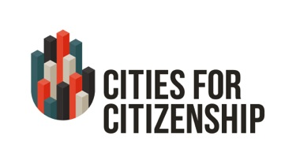






Finding Eligible Legal Permanent Residents and Using Data to Reduce Naturalization Barriers In Your City
March 17, 2015

Slide 2

About the Initiative
Cities for Citizenship (C4C) is a major national initiative aimed at increasing citizenship among eligible U.S. permanent residents and encouraging cities across the country to invest in citizenship programs. C4C is chaired by New York City Mayor Bill de Blasio, Chicago Mayor Rahm Emanuel, and Los Angeles Mayor Eric Garcetti, with support from the Center for Popular Democracy and the National Partnership for New Americans. Citi Community Development is the Founding Corporate Partner.
Participating Cities:
Atlanta, GA · Baltimore, MD · Boston, MA · Chattanooga, TN · Chicago, IL· Denver, CO · Los Angeles, CA· Nashville, TN · New York, NY · Milwaukee, WI · Philadelphia, PA · Pittsburgh, PA · Seattle, WA · Washington, DC

Slide 3
Introductions
Frances Liu, Program Manager, Citi Community Development
Rob Paral, Principal of Rob Paral and Associates
Shanna Singh Huey, Director of the Office of New Americans and Senior Advisor to Mayor Karl Dean, City of Nashville
Camilla Fyler, Legal Services Manager, Tennessee Immigrant and Refugee Rights Coalition (TIRRC)

Slide 4
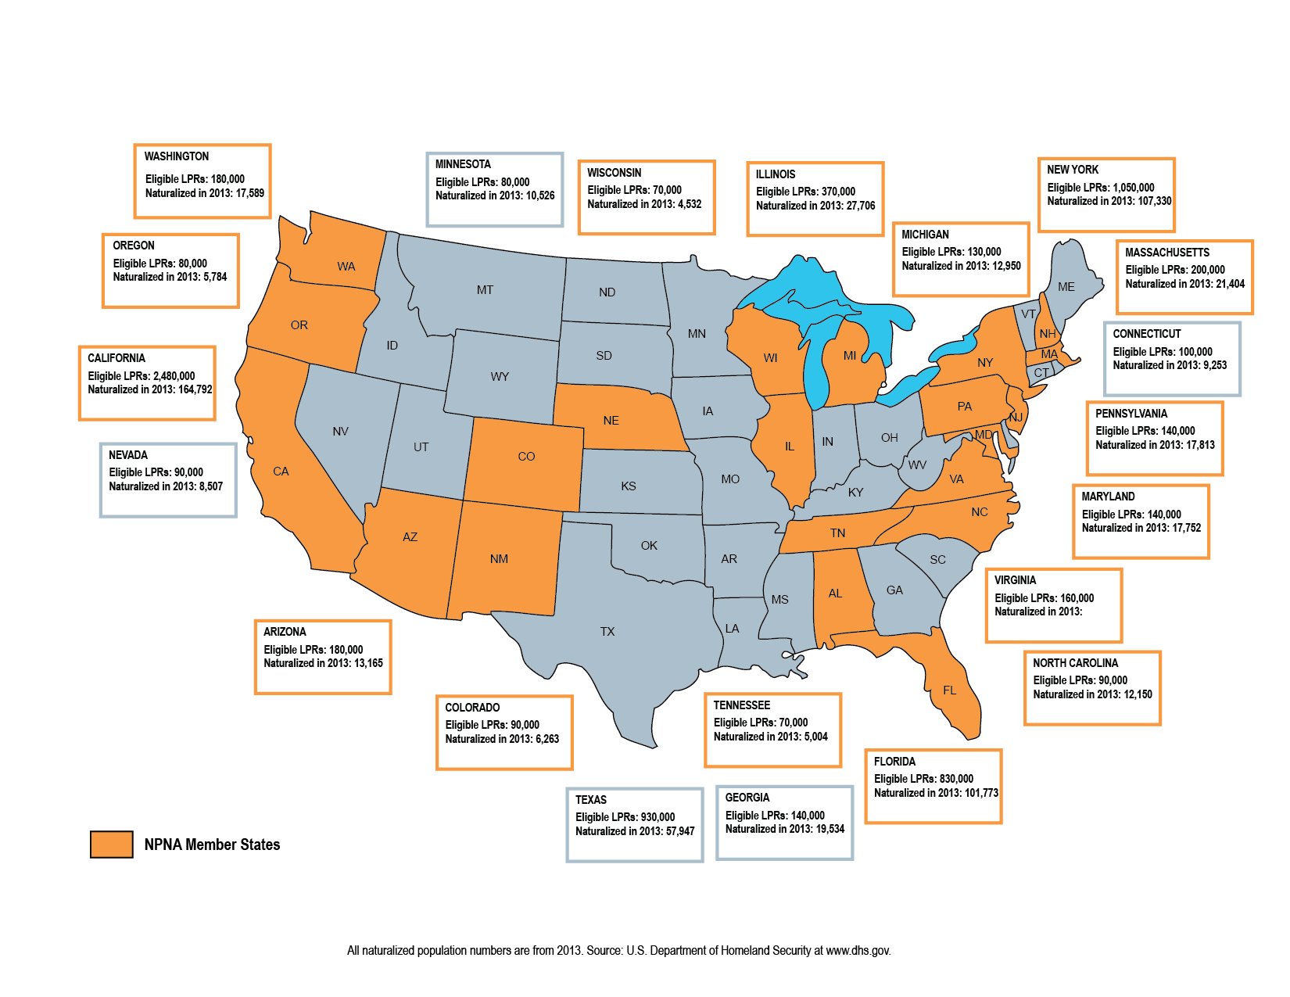
Where are the 8.8 Million ? Who are they?

Slide 5
Why use data?
To target outreach to LPRs – especially in rural areas and areas where there are few service providers
To measure the impact of naturalization efforts
To help cities and partners build capacity where it is needed most
To understand naturalization barriers and develop strategies to address those barriers

Slide 6
Tools and Resources
To Identify and Reach
Eligible LPR’s
By Rob Paral
rob@robparal.com
www.robparal.com

Slide 7
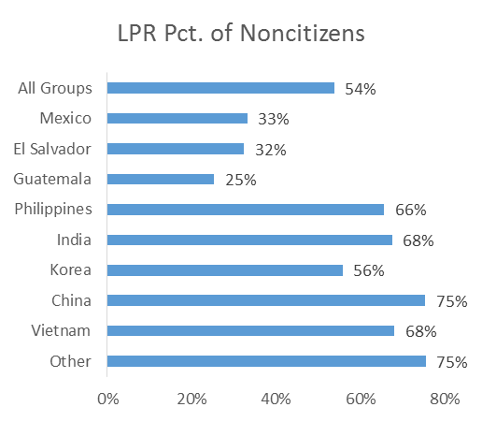
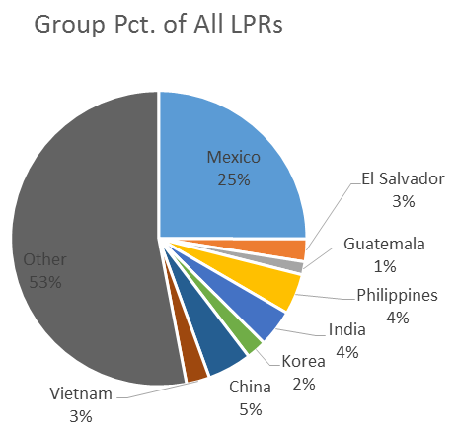
Tool #1: Know the Market
Who Is Most Likely to Be Eligible?
Who Is the Largest Group of Eligible LPR’s?

Slide 8
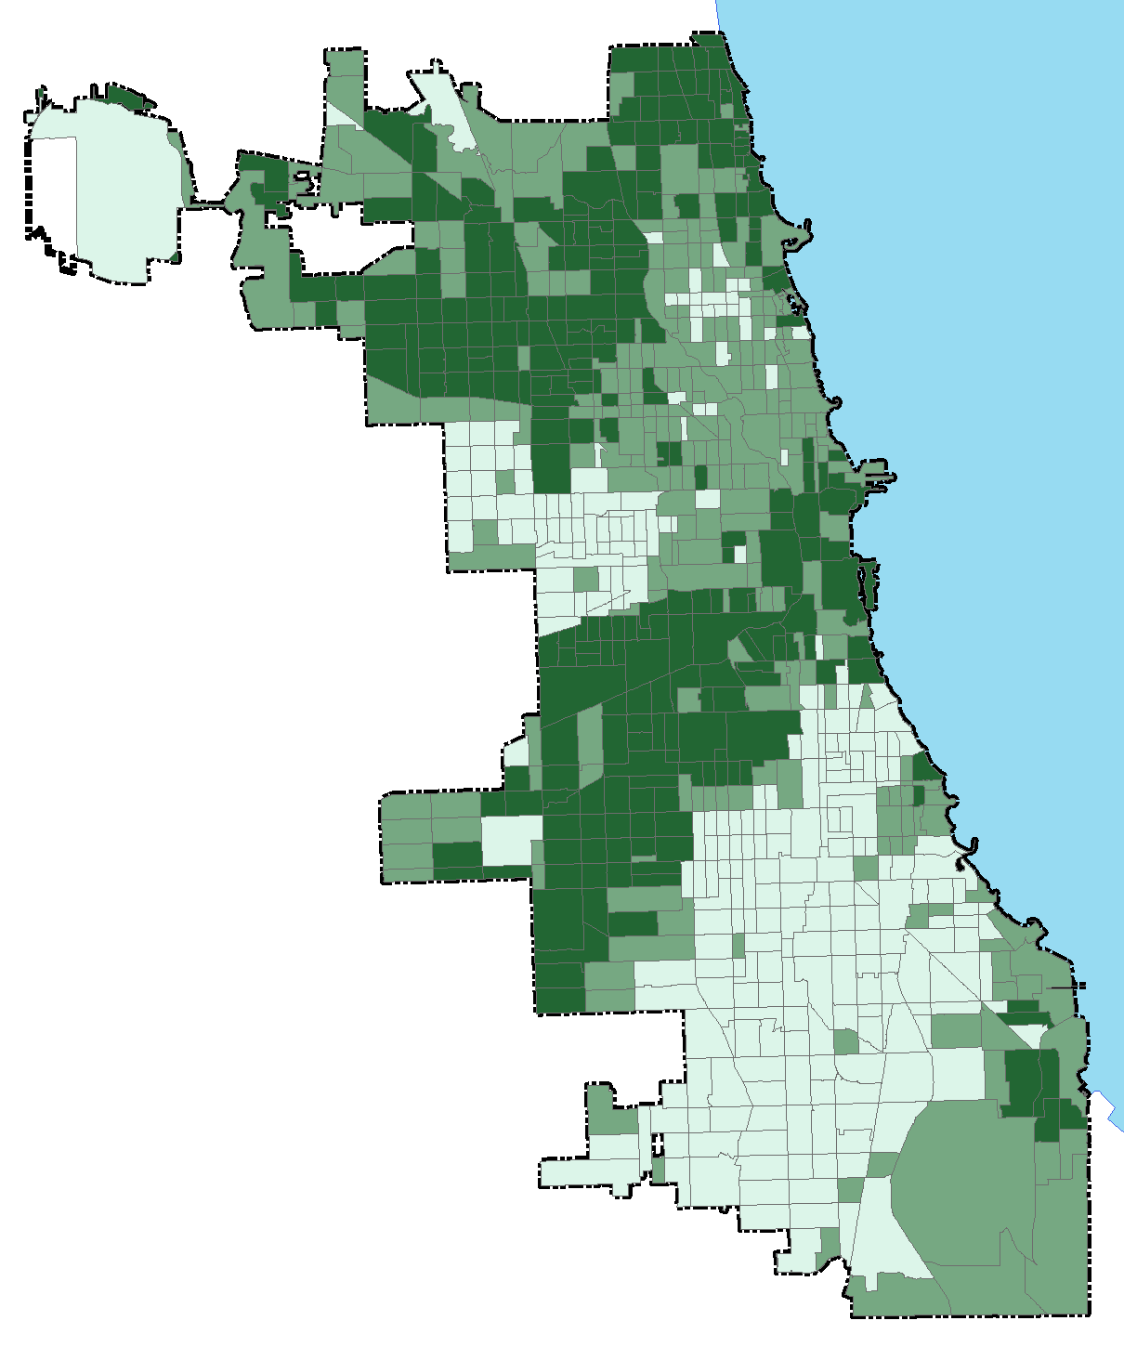
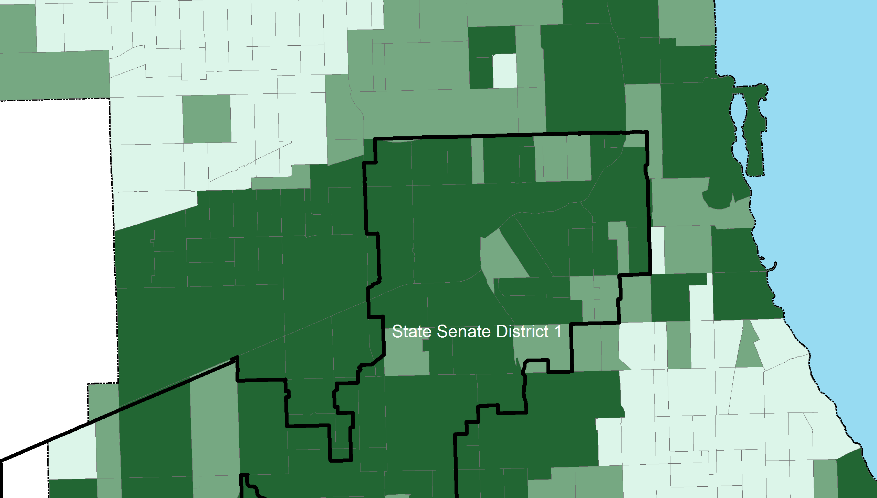
Tool #2: Drill Down
Use Granular Data to Identify Partners
Census Tracts
State Senate District

Slide 9
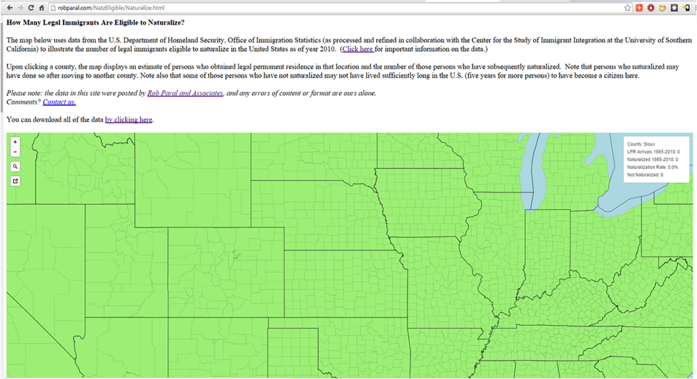
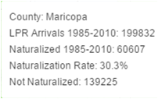
Tool #3: Use the County LPR-Finder
http://www.robparal.com/NatzEligible/Naturalize.html

Slide 10
A Municipal Approach to Using Data
City of Nashville, Office of New Americans
Shanna Singh Hughey, Senior Advisor and Director Office of New Americans
Office of Mayor Karl Dean

Slide 11
City of Nashville
First question: Do we need a Mayor’s Office of New Americans?
Demographic data:
  New Americans now make up more than 12% of Nashville’s overall population.
  Between 2000 and 2012:
    Nashville’s foreign-born population grew by more than 86%, while the native-born population grew by 11%.
    Immigrants accounted for nearly 60% of Nashville’s overall population growth.

Slide 12
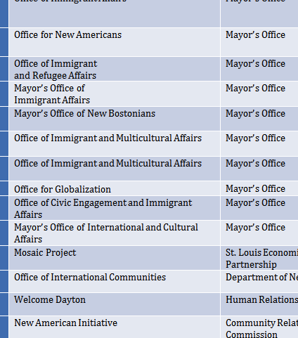
Second question: How should the office be structured?

Slide 13
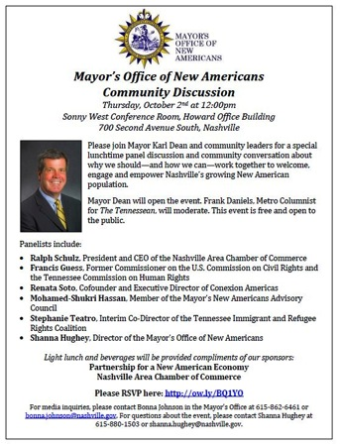
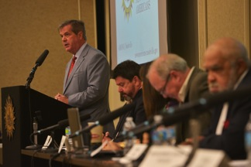
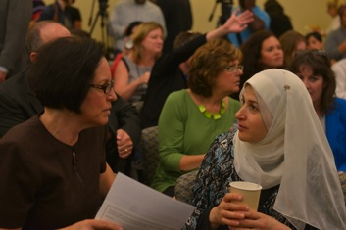
City of Nashville
Third question: What should the office do?

Slide 14
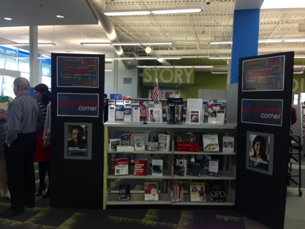
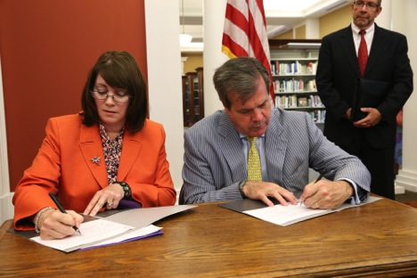
City of Nashville
Pathway for New Americans

Slide 15

A Community Partner’s Approach
Camila Fyler
Immigration Services Manager

Slide 16
Tennessee Immigrant & Refugee Rights Coalition
Began naturalization programming in 2007
In 2012, participated in Become a Citizen Now campaign with National Partnership for New Americans
Have assisted 500 individuals with the naturalization process
Effective Partnerships with the Office of New Americans in Nashville and the City of Chattanooga to reach more LPRs collectively
Experts at using community data

Slide 17

Questions?

Slide 18
Resources
http://www.robparal.com/NatzEligible/Naturalize.html
http://www.dhs.gov/immigration-statistics-publications
http://www.uscis.gov/citizenship/organizations/citizenship-and-integration-grant-program-promising-practices
http://www.immigrationpolicy.org/just-facts/economic-and-political-impact-immigrants-latinos-and-asians-state-state

Slide 19






Thank you For Joining us!
Atlanta, GA · Baltimore, MD · Boston, MA · Chattanooga, TN · Chicago, IL · Denver, CO · Los Angeles, CA · Nashville, TN · New York, NY · Milwaukee, WI · Philadelphia, PA · Pittsburgh, PA · Seattle, WA · Washington, DC
www.citiesforcitizenship.org
For more information contact cities4citizenship@populardemocracy.org

