Slide 1
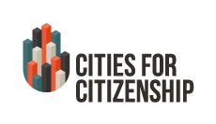

Scaling Up:
Innovative Strategies For Expanding Naturalization Capacity In Your City
July 9, 2015

Slide 2
Cities for Citizenship (C4C) is a major national initiative aimed at increasing citizenship among eligible U.S. permanent residents and encouraging cities across the country to invest in citizenship programs. C4C is chaired by New York City Mayor Bill de Blasio, Chicago Mayor Rahm Emanuel, and Los Angeles Mayor Eric Garcetti, with support from the Center for Popular Democracy and the National Partnership for New Americans. Citi Community Development is the Founding Corporate Partner.
Participating Cities:
Atlanta, GA · Baltimore, MD · Boston, MA · Chattanooga, TN · Chicago, IL · Denver, CO · Los Angeles, CA· Nashville, TN · New York, NY · Milwaukee, WI · Philadelphia, PA · Pittsburgh, PA · Reading, PA · San Francisco, CA ·
San Jose, CA · Seattle, WA · Washington, DC

Slide 3
Introductions
Alejandra St. Guillen, Director, Mayor’s Office of New Bostonians, City of Boston
Lindsey Bishop, Immigrant Program Manager, Mayor's Office of Immigrant and Multicultural Affairs, City of Baltimore
Zulma Maciel, Strategic Partnerships Manager, Office of Immigrant Affairs, City of San Jose
Moderators: Nicole Melaku, National Partnership for New Americans & Shena Elrington, Center for Popular Democracy

Slide 4
Building Naturalization Capacity to Scale
Goals for today’s webinar:
Highlight various levels of program development to demonstrate the continuum of naturalization programs led by participating C4C cities;
Share ideas on building capacity for naturalization work in your city; and
Provide additional resources to engage key stakeholders, including inter-agency departments and community partners, to expand current efforts.

Slide 5
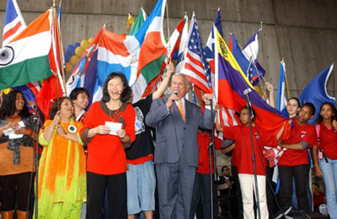
City of Boston
Alejandra St. Guillen, Director of the Mayor's Office of New Bostonians

Slide 6
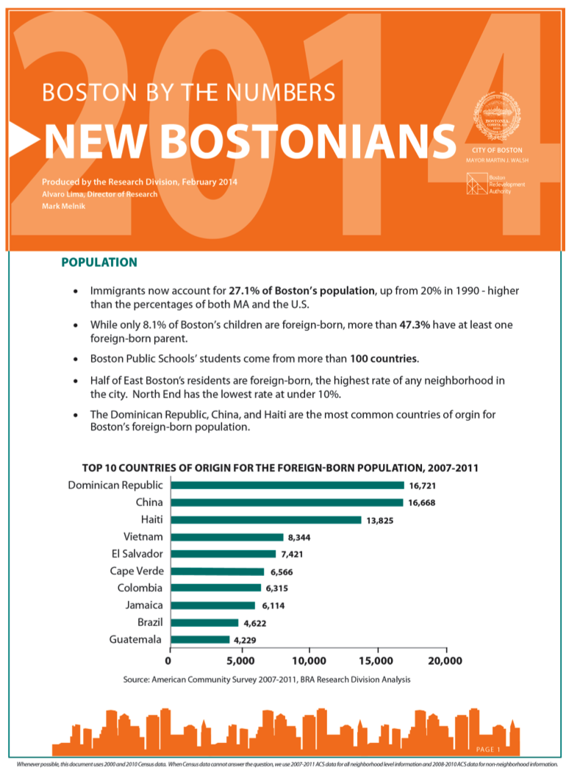
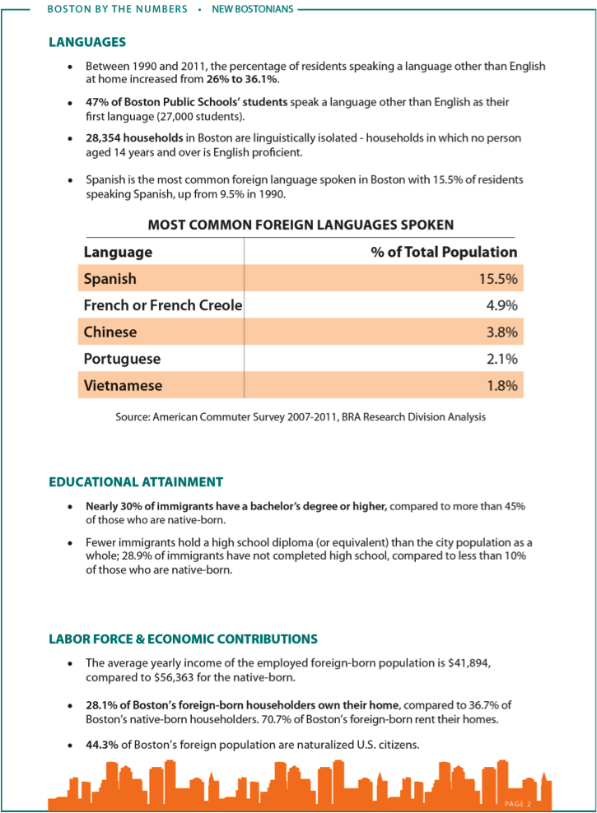

Slide 7
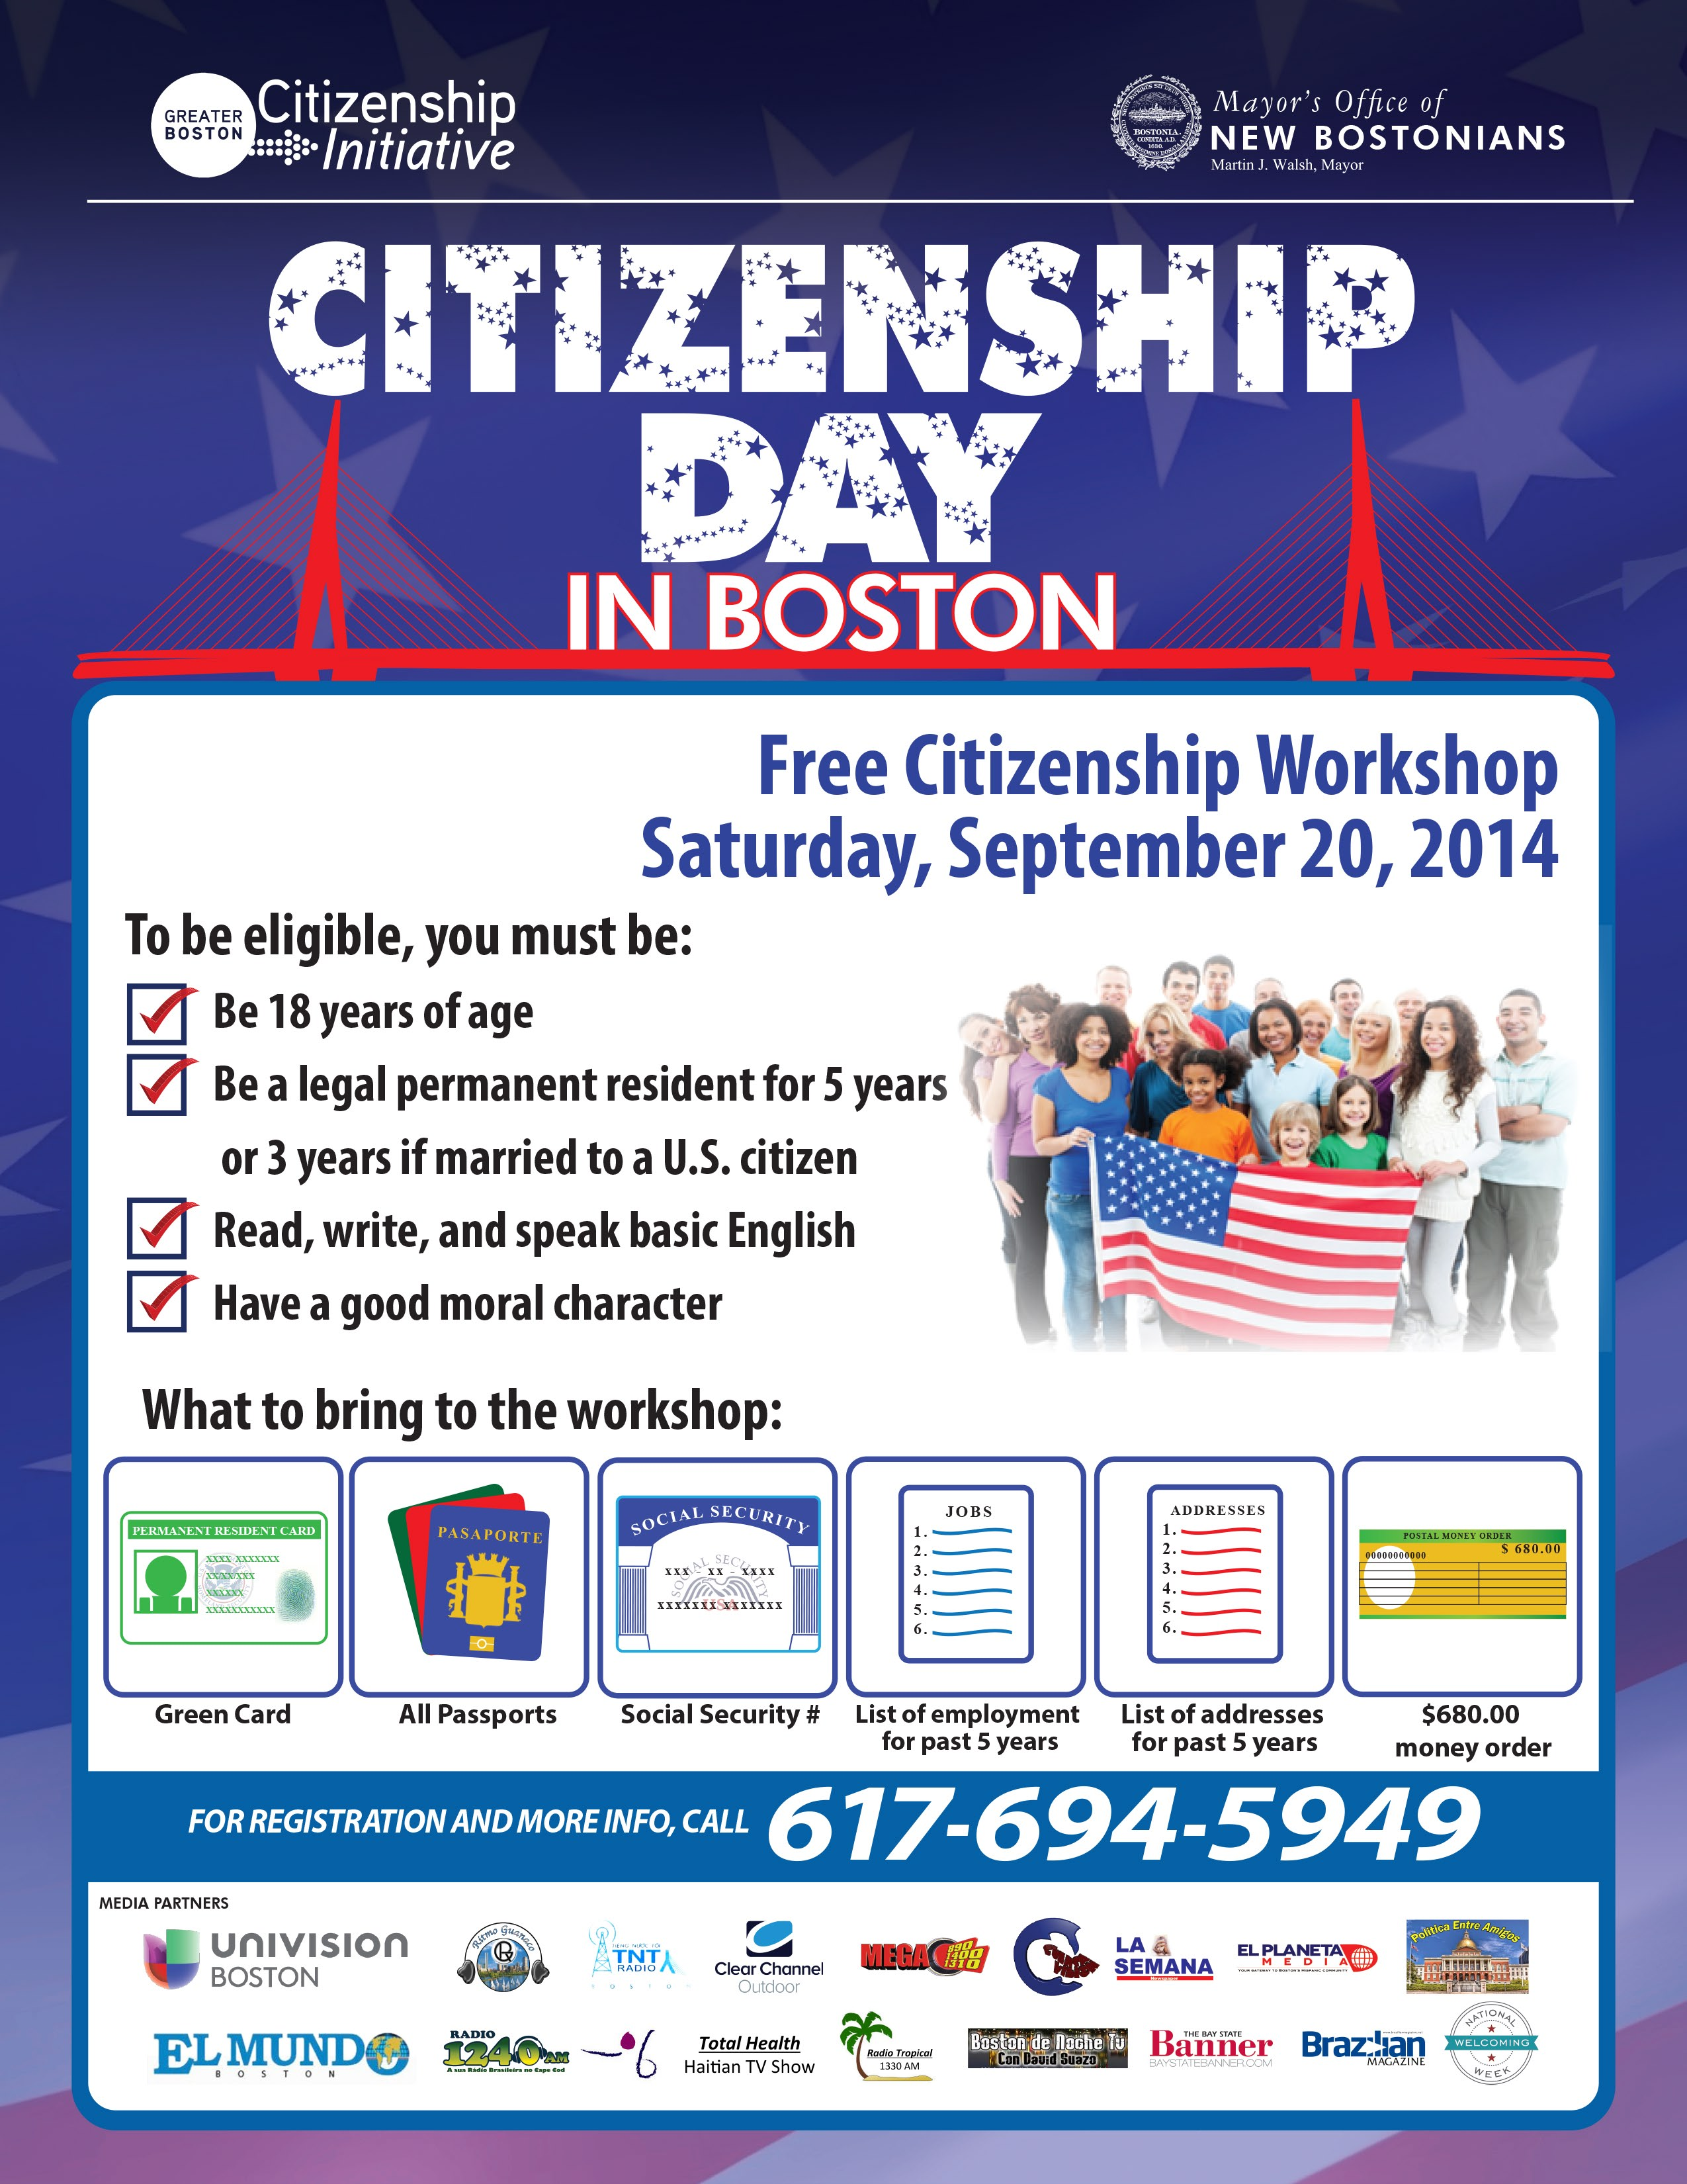
Public - Private Partnerships
Citizenship Day 2014
In partnership with Project Citizenship (pre-screening, logistics, attorney recruitment). Office of New Bostonians, in collaboration with Office of Health & Human Services in charge of locations, media and outreach.
Cross-city effort: 5 simultaneous clinics across the city on the same day (major communities reached: Cape-Verdean, Haitian, Central American/Colombian, Dominican, Brazilian)
Day of clinic: nearly 200 people served, follow-up clinics: additional 30-40 people served
Planning for Citizenship Day 2015 underway

Slide 8
City of Boston’s Commitment to Naturalization
2014 – Building a Foundation
  Mayor Walsh presides over Naturalization Ceremony in historic Faneuil Hall;
  City hosts Naturalization Ceremony in the Office of the Mayor;
  Mayor Walsh pens an opinion piece for National Journal on How Boston Encourages U.S. Citizenship (http://www.nationaljournal.com/next-america/perspectives/how-boston-encourages-u-s-citizenship-20140924)
  Office of New Bostonians, Office of Health & Human Services and Boston Centers for Youth & Families partner with Project Citizenship to host Citizenship Day 2014.
  City of Boston joins Cities for Citizenship
2015 – Scaling Up
  City of Boston launches New American Corners
    VISTA/AmeriCorps Partnership (staffing)
    In collaboration with the Office of Financial Empowerment (joint funding)
    Letter of Agreement with USCIS (resources, materials)
    Stakeholder meeting to build support (from NGOs & Funders)
  Citizenship Day 2015

Slide 9
City of Baltimore
Lindsey Bishop, Immigrant Program Coordinator for Mayor’s Office of Immigrant & Multi-Cultural Affairs (MIMA)

Slide 10

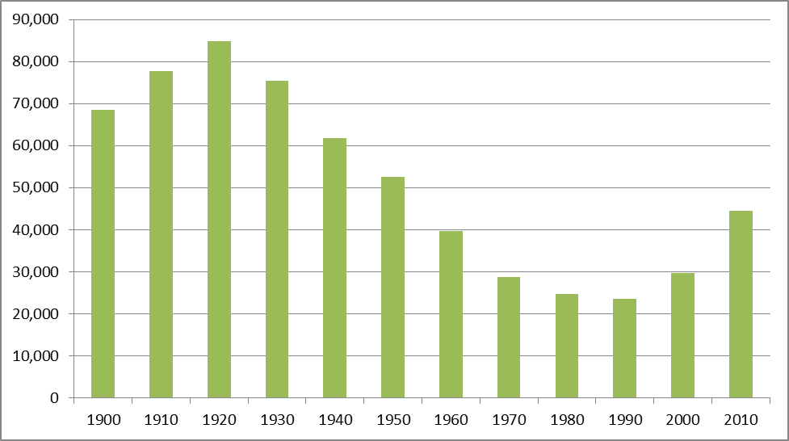
Building Support
    Summer 2013: The New Americans Task Force
    Mayor Stephanie Rawlings-Blake as a strong advocate
    -May 2014: Creation of MIMA
    -September 2014: Role of Immigrants in Growing Baltimore released
    -July 2015: Implementation of 6 to 9 Recommendations, including recommendation promoting citizenship and the removal of barriers.
    (Rawlings-Blake Review: Commemorating Our Nation’s Independence.)
    Data: Baltimore’s Immigrant Community Over Time (1900-2010)

Slide 11
Pr Promotion of and Access to Citizenship
Solidifying Partnerships
    U.S Census Bureau
    Paul D. Coverdell Fellows-University of Maryland-School of Social Work
    Neighborhood Housing Services
    Service Providers
    Enoch Pratt Free Libraries
    USCIS (including use of new citizenship outreach materials)
Focus on Financial Capacity-Building
    Financial literacy
    Small Dollar Loans
    Connectivity to small business and homeownership programs
Addressing Challenges
    Data
    Strategic & Targeted Outreach
    Starting Small & Building Sustainability

Slide 12
CITY OF SAN JOSE
Zulma Maciel, Assistant to the City Manager, Office of Immigrant Affairs
“Our evolution over the past 50 years, from an agricultural community to become the world’s leading center of technology innovation is attributed to the entrepreneurial spirit of the people of San Jose, who have come to reside here from all corners of the world and together have grown our economy and our cultural heritage. The success of San Jose relies in good measure on facilitating citizenship for our immigrant population.”
- Mayor Sam Liccardo

Slide 13
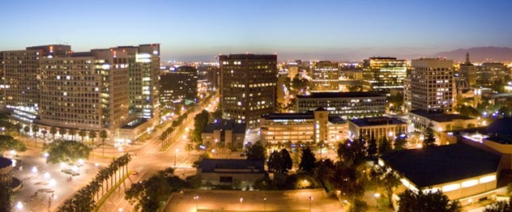
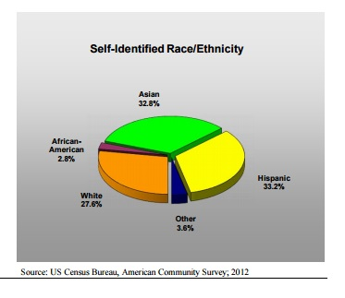
City of San Jose, California
San Jose Population: 1,015,785
• Largest City in Bay Area/Northern CA
• 3rd Largest City in California
• 10th Largest City in the United States
LANGUAGE SPOKEN AT HOME
English 43%
Spanish 24%
Asian/Pac. Is. 26%
Other 7%

Slide 14
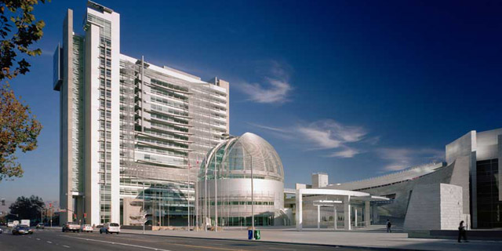
San Jose Office of Immigrant Affairs
Mayor and City Council directive:
Support local efforts related to President Obama’s Executive Action on Immigration
Develop a long-term plan for immigrant integration
Office of Immigrant Affairs established in 2015
Short-term Wins:
Cities United for Immigration Action
Cities for Citizenship
$250k for implementation of DACA/DAPA
1 FTE

Slide 15
San Jose for Citizenship [short-term]
190,000 LPRs in the County 14% of eligible residents apply each year
2015-2016 Partnership with United Way Silicon Valley, County of Santa Clara, Community Based Organizations and USCIS Supported by Citi Community Development and City of San Jose
Linguistically and culturally competent public outreach campaign
Create Citizenship/New American Corners at San Jose Libraries
Training on the basics of the naturalization process for community center, library, and call center City staff
Training for CBO staff on financial literacy and develop ways to integrate into citizenship information sessions
Naturalization Ceremony in coordination with a professional sports team
Host Citizenship Day on September 17th.

Slide 16
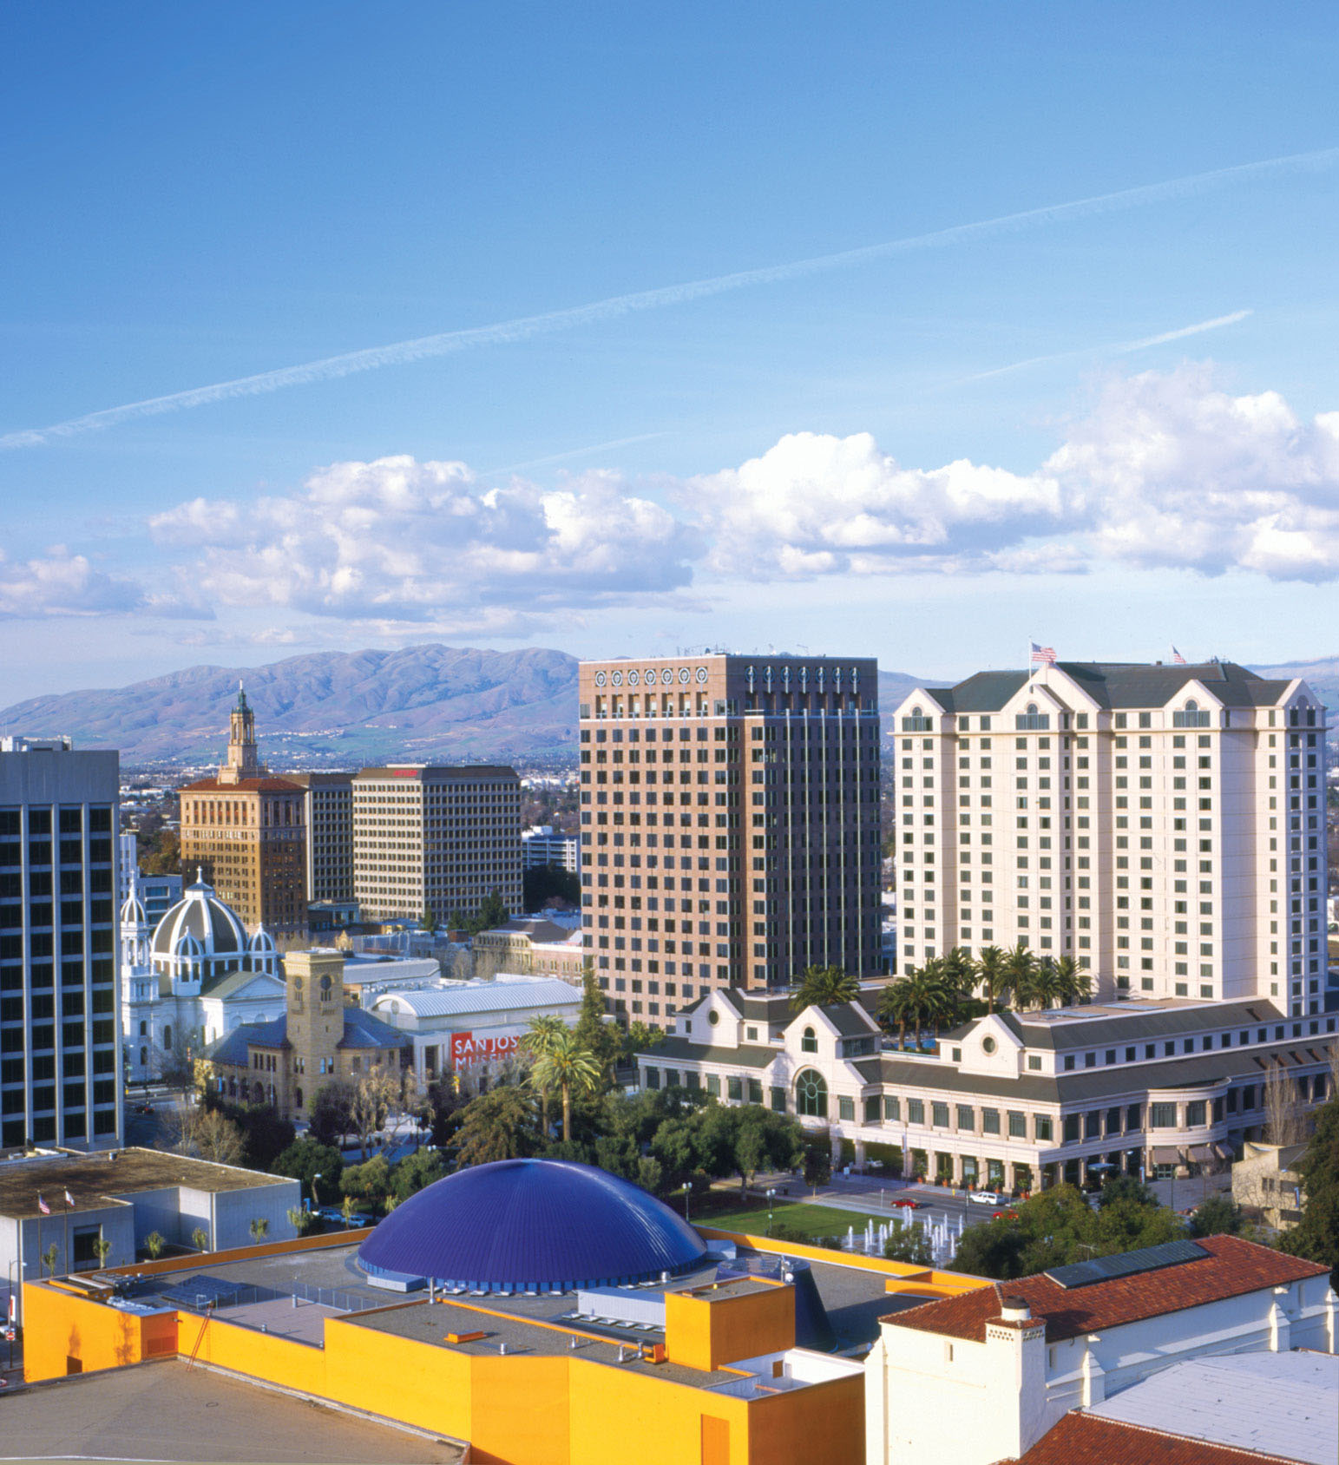
San Jose for Citizenship [long-term]
Minimize barriers through:
Education outreach
English and citizenship test preparation services
Microloans to cover application fee
Strategy for Growth:
Identify opportunities for City departments to get involved
Determine City’s role in County Citizenship Collaborative
Work with financial institutions to offer microloans
Create a prospect profile list of potential private funders and an associated fund development plan

Slide 17
Strategies for Expanding Naturalization Work in Your City
Find the “Integration hubs” in your community. Citizenship Corners are low-cost and USCIS has many resources on-line to create one.
Explore innovative staffing models to expand the work: AmeriCorps, interns, and community volunteers are crucial for outreach strategies.
Develop public-private partnerships and collaborative fundraising models.
Involve commissioners and community stakeholders in the long-range strategic planning to ensure naturalization work is institutionalized beyond the current administration.

Slide 18
Setting up a New Americans Corner
USCIS provides detailed steps on setting up a citizenship corner: http://www.uscis.gov/citizenship/organizations/libraries/citizenship-corners
Download the USCIS Civics & Citizenship Toolkit
Have plenty copies of Form N-400 available
Download and print 10 Steps to Naturalization USCIS Guide

Slide 19
Staffing Suggestions
Create pipeline for future staffing through Americorps and intern placements.
Partner with Volunteers of America, Peace Corps (returned volunteers) and universities

Slide 20
Discussion
What challenges and opportunities does your initiative face in expanding current naturalization work? How have you addressed those challenges?

Slide 21




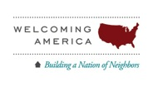
Atlanta, GA · Baltimore, MD · Boston, MA · Chattanooga, TN · Chicago, IL · Denver, CO · Jersey City, NJ ·Los Angeles, CA· Nashville, TN · New York, NY · Milwaukee, WI · Philadelphia, PA · Pittsburgh, PA · Reading, PA · San Francisco, CA ·
San Jose, CA· Seattle, WA · Washington, DC
www.citiesforcitizenship.org
For more information contact cities4citizenship@populardemocracy.org

