Slide 1
CITIZENSHIP: A MEANS TO FINANCIAL EMPOWERMENT
April 28, 2015

Slide 2
About the Initiative
Cities for Citizenship (C4C) is a major national initiative aimed at increasing citizenship among eligible U.S. permanent residents and encouraging cities across the country to invest in citizenship programs. C4C is chaired by New York City Mayor Bill de Blasio, Chicago Mayor Rahm Emanuel, and Los Angeles Mayor Eric Garcetti, with support from the Center for Popular Democracy and the National Partnership for New Americans. Citi Community Development is the Founding Corporate Partner.
Participating Cities:
Atlanta, GA · Baltimore, MD · Boston, MA · Chattanooga, TN · Chicago, IL · Denver, CO · Jersey City, NJ · Los Angeles, CA · Milwaukee, WI · Nashville, TN · New York, NY · Philadelphia, PA · Pittsburgh, PA · Reading, PA · San Francisco, CA · San Jose, CA ·
Seattle, WA · Washington, DC

Slide 3
Introductions
Eileen Auld, Director, NY Tri State Market, Citi
Cathie Mahon, President/CEO, National Federation of Community Development Credit Unions
Sonia Lin, General Counsel, Mayor’s Office of Immigrant Affairs, New York City
Joseph Bernardo, Policy Analyst, Office of Immigrant Affairs, Los Angeles
Nicole Melaku, Director of Programs, National Partnership for New Americans
Shena Elrington, Director of Immigrant Rights & Racial Justice Policy, Center for Popular Democracy

Slide 4
CITIZENSHIP & FINANCIAL EMPOWERMENT
Combining citizenship efforts with final empowerment strategies is an opportunity to build a stronger and more inclusive economy for all. Becoming a citizen has clear measurable impact for legal permanent residents and the communities in which they live.
With nearly 9 million eligible legal permanent residents eligible to become citizens today, many institutions have created innovative collaborations to encourage economic growth, innovation, and prosperity for all.

Slide 5
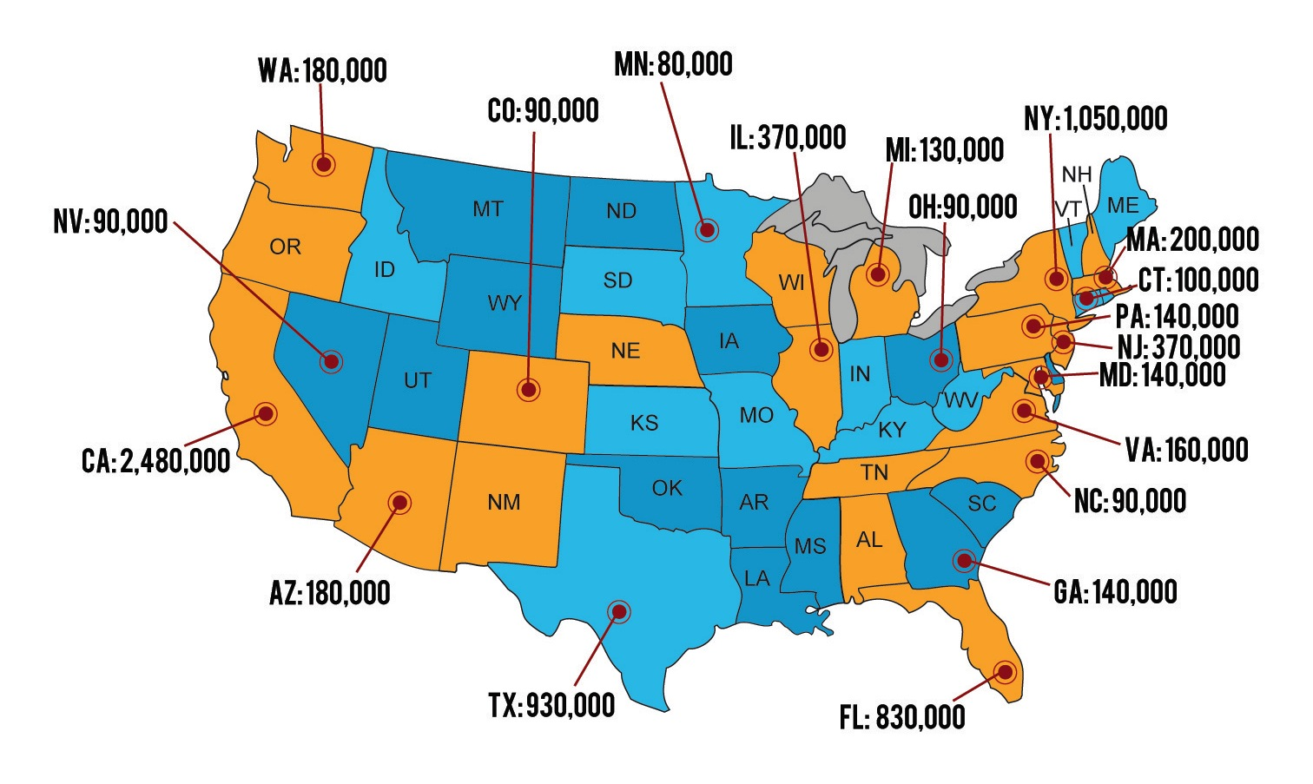
Where are the 8.8 million eligible LPRs who are eligible to naturalize?

Slide 6
Citizenship: A Catalyst For Financial Empowerment
Data collected from the American Community Survey and the 2011 Census indicate that home ownership increases among naturalized citizens compared to non-citizens.²
According to 2013 Census data, 1 in 7 homeowners were foreign born. Sixty-six percent of naturalized citizens owned their own homes relative to 34% of non-citizens.
www.facethefactsusa.org/facts/homeownership-more-likely-when-immigrants-us-stay-longer
2. Edward Trevylan, Yesenia Acosta, , Patricia de la Cruz, US Department of Commerce, Economics and Statistics administration, US Census Bureau

Slide 7
Citizenship: A Wise Return on Investment
Naturalized citizens earn 8-11% more than non naturalized immigrants.
Naturalized citizens are less likely to live below the poverty level - 6% compared to 16% of non-naturalized citizens.³
82% of naturalized citizens have health insurance compared to 49% of non-naturalized citizens.
Educational attainment increases dramatically among newly naturalized citizens. USCIS, CSSI data indicates that 22% of New Americans held bachelors degrees compared to 10% of non-naturalized citizens.
See Figure 2. Scoggins, Pasto. 2012 Citizenship Gain. Citizen Gain: The Economic Benefits of Naturalization for Immigrants and the Economy. Center for the Study of Immigrant Integration. http://csii.usc.edu/CitizenGain.htm p. 7

Slide 8
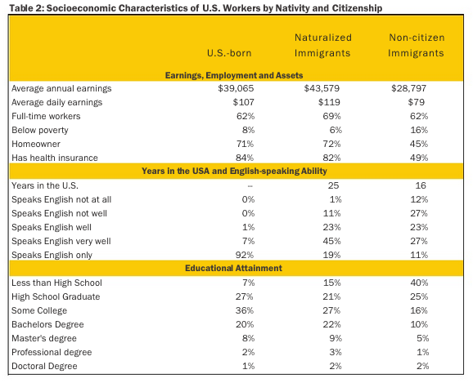
Figure 2. Scoggins, Pasto. 2012 Citizenship Gain. Citizen Gain: The Economic Benefits of Naturalization for Immigrants and the Economy. Center for the Study of Immigrant Integration. http://csii.usc.edu/CitizenGain.htm p. 7

Slide 9
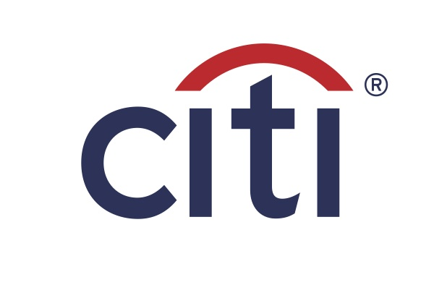
Eileen Auld
Director, NY Tri State Market, Citi

Slide 10
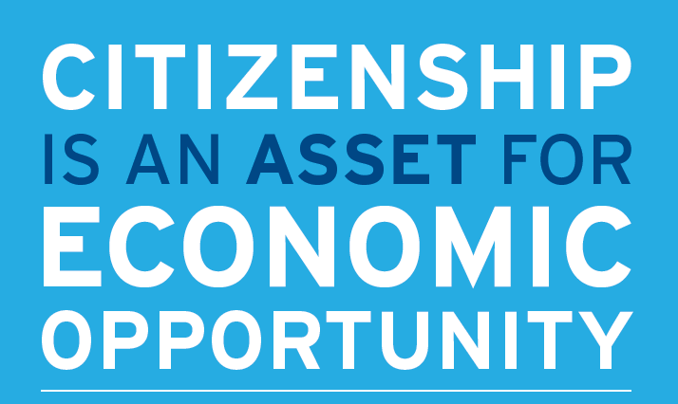
Why citizenship?
Increased earnings
Educational + economic opportunities
Economic boost for cities

Slide 11
Immigrant Financial Empowerment
Immigrant Financial Services Study (NYC)
Proven Interventions
1-on-1 financial coaching
EITC and free tax preparation services
Tailored consumer products
Financial education connected to action
Integrating interventions into programs
Goal = Behavioral Change

Slide 12
Naturalization + Financial Empowerment Strategies
Integrate financial counseling into service delivery programs
Partner with credit unions
Connect municipal offices

Slide 13
Promoting Financial Inclusion for Immigrant Consumers with Community Development Credit Unions Cathie Mahon

Slide 14
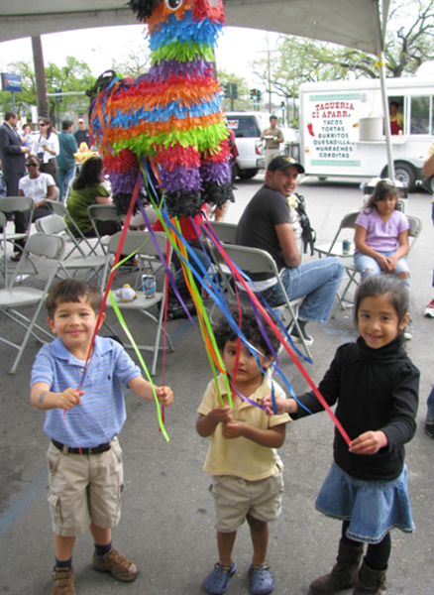
Who we are
Mission: To help low- and moderate-income people and communities achieve financial independence through credit unions.
Organize, support and invest in credit unions serving LMI consumers
Promote innovative approaches to reaching underserved populations with safe responsible products
Fast growing network of more than 208 member credit unions in 46 states

Slide 15
Reaching Unbanked Immigrant Populations
Research shows immigrants with documented status have higher rates of being “banked” despite equal rates of reporting regular savings.
CDCUs embrace immigrant-friendly policies and procedures with Flexible Customer ID programs (accepting matriculas, municipal IDs, passports, etc.)
Immigration and legalization processes provide a pivotal moment to encourage people to gain access to safe and responsible financial services.

Slide 16
Reaching Unbanked Immigrant Populations
CDCUs offer relevant and affordable financing for immigrant individuals and families:
Savings and affordable transactions (Cards, Remittances)
Credit Builder products
ITIN loans
Affordable Homeownership
Small Business and Microenterprise loans
Citizenship/DACA loans
Low and transparent costs
Financial counseling and coaching directly or through community and nonprofit partners
Notes:
Linking up with IRS to:
Provide free tax preparation services to qualifying individuals (Volunteers in Income Tax Assistance –VITA Program)
Participate as ITIN Acceptance Agent Program

Slide 17
Citizenship Loans
Application fee and renewal fee presents a barrier for many
CDCUs from New York to California launched micro-loan programs to help immigrants pay for citizenship and other immigration application fees
Opportunity to connect immigrants and their families to mainstream financial services and become banked
Fosters trust of financial institutions as a helpful agents to immigrant communities

Slide 18
Loan Pilots
General Product Terms:
Small dollar loans <$1000
6-12 month terms
Flexible underwriting criteria and rapid approvals
Various means to determine borrowing history
Some require small amount of documented income
Checks made out to USCIS and other relevant government agencies
Experiences varied
Notes:
Loan Loss Reserves enable credit unions to take greater flexibility in underwriting
Some loan programs are 100% reserved; others have internally allocated reserves
Losses to date have generally been limited
More data is needed to provide sufficient cushion to convince regulators to allow no credit checks and limited income documentation

Slide 19
Example: NWA Immigrant Asset-Building Initiative
The Federation and GCIR pilot connecting credit unions with non-profit partners. First 2 quarters:
53 loans for $280K; combination of citizenship, DACA, family petitions, waivers
High number of vehicle loans and personal loans, a residual impact of partnership events, 21 ITIN-based
40+ Checking/Savings accounts added
Strong participation at Financial literacy workshops
32 Avg. Age of Borrower, 64% of borrowers male, 630 avg. credit score; majority Hispanics, African

Slide 20
Other Examples
More than 40 documented pilots underway; 33 accept ITINs and offer citizenship/DACA loans or small dollar loans with flexible underwriting
Latino Community FCU (NC) leads with 1,578 DACA loans, 1.7% charge-off rate (since 2012)
Northside Community FCU (IL): 350 citizenship loans, 5% charge-off rate (since 2007)
District Government Employees’ FCU (DC): more than 200 citizenship/DACA loans (since 2014)
New Economy Project with Brooklyn Cooperative and Lower East Side People’s: 100 DACA loans (since 2014)

Slide 21
Implementation Lessons Learned
Implementation, Outreach and Promotion:
Trusted partnerships are key between credit unions and immigrant and legal services organizations
Offering a broad array of services may help people recognize this is about making a lifelong relationship not simply “selling a loan”
Critical that this is seen as a credit-building process.
Staging of implementation can affect take-up – we need to be ready.

Slide 22
For more information
National Federation of Community Development Credit Unions
39 Broadway, Suite 2140
New York, NY 10006
www.cdcu.coop
Cathie Mahon
cmahon@cdcu.coop

Slide 23
Sonia Lin
General Counsel, Mayor’s Office of Immigrant Affairs, New York City

Slide 24
Program Elements
Partners
Outreach
Citizenship application assistance, including fee waiver assistance
Additional financial empowerment services

Slide 25
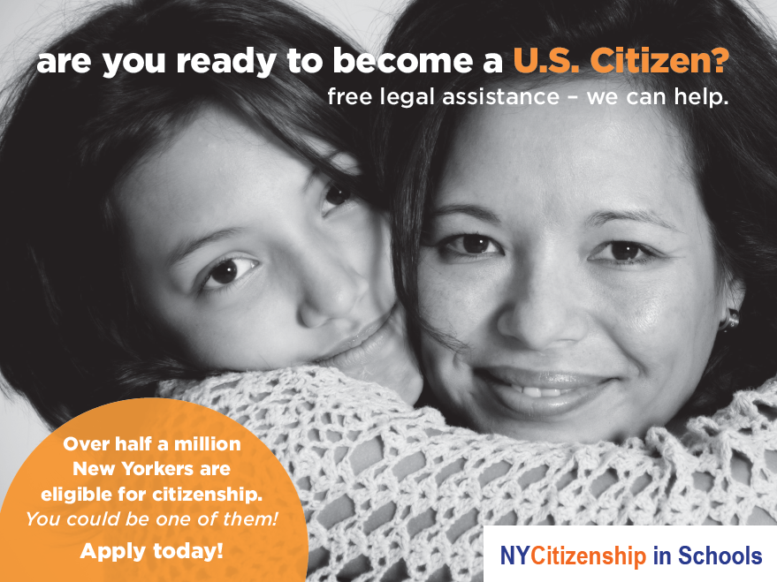
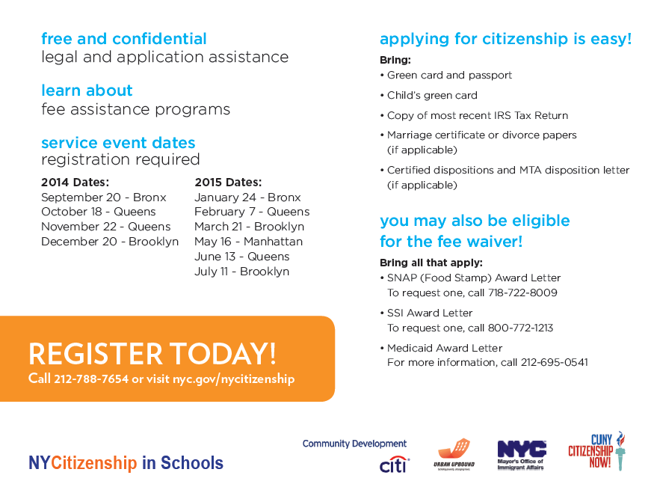

Slide 26
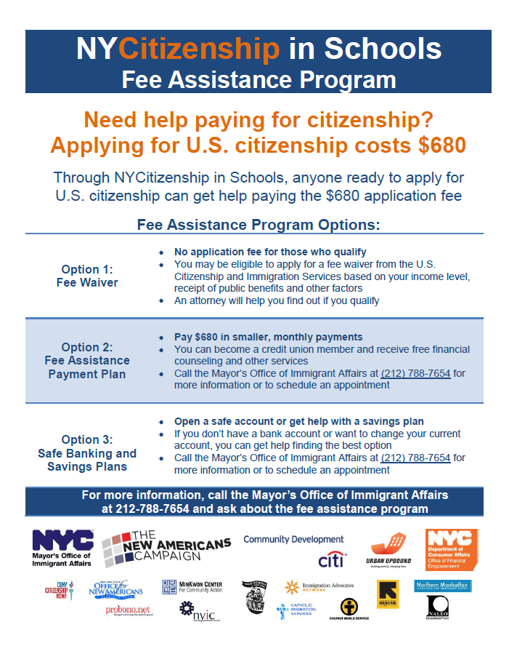

Slide 27
Creating Financial Education Programs for Aspiring Citizens in Los Angeles Joseph Bernardo, Policy Analyst Office of Immigrant Affairs, Los Angeles

Slide 28
The Case for Financial Education
Legal Permanent Residents (LPRs)
more than 750,000 in LA County and
350,000 in the City of Los Angeles
52% of which are low-income
Naturalized citizens earn 45% more than non-citizen immigrants, who earn close to 11% more soon after they become U.S. citizens
Economic Impact: $1.9–3.3 Billion

Slide 29
Cities for Citizenship
Community Partners
National Association of Latino Elected and Appointed Officals (NALEO)
Asian Americans Advancing Justice – Los Angeles
Coalition for Humane Immigrant Rights Los Angeles (CHIRLA)
International Rescue Committee (IRC)
Youth Policy Institute (YPI)
Institutional Partner
Los Angeles Public Library (LAPL)
Financial Partners
Pacoima Development Credit Union
Self Help Development Credit Union
Citibank

Slide 30
Cities for Citizenship
Measuring Success
- Goal: 3000 individuals over 2 years
Tips for implementing programs in your city
- Leverage existing resources
- Identify right community partners
- Develop relationships with financial institutions

Slide 31
How Can Public and Private Partnerships Build Inclusion and Economic Empowerment Through Citizenship?
The White House Task Force on New Americans
April 2015 President Obama launched the Task Force with input from community organizations, A Federal Strategic Action Plan for Immigrant and Refugee Integration
A key component of this task force plan is identifying and strengthening economic inclusion of New Americans
Strengthening pathways to citizenship through public awareness campaigns through DHS
Presidential Ambassadors of New Americans to promote citizenship and naturalization
Citizenship and Integration Grants totaling $10 million dollars
Expand Citizenship Outreach Partnerships

Slide 32
Key Allies in Building Financial Empowerment
Federal Government
State and Local
Agencies on the White House Task Force for New Americans
US Department of Labor
US Department of Commerce
US Small Business Administration
White House Economic Council
Office of Management
State Office’s of Economic Development
State Office Small Business Administration
State Offices on Workforce Development
Municipal Offices Mayors office on workforce of Economic Development
Offices of New Americans
Offices of Immigrant and Refugee Affairs
Offices of Economic Development
Offices of Community Development

Slide 33
Questions?

Slide 34
Resources
National Federation of Community Development Credit Unions (http://www.cdcu.coop/about-us/)
Center for Responsible Lending (http://www.responsiblelending.org/)
White House Task Force on New Americans (https://www.whitehouse.gov/issues/immigration/new-americans)
Citizenship: A Wise Investment for Cities (http://www.citiesforcitizenship.org/Cities_for_Citizenship.pdf)

Slide 35
Thank you For Joining us!
Atlanta, GA · Baltimore, MD · Boston, MA · Chattanooga, TN · Chicago, IL · Denver, CO · Los Angeles, CA· Nashville, TN · New York, NY · Milwaukee, WI · Philadelphia, PA · Pittsburgh, PA · Reading, PA · San Francisco, CA ·
Seattle, WA · Washington, DC
www.citiesforcitizenship.org
For more information contact cities4citizenship@populardemocracy.org

